Slide 1
Theory Building
Dirk Riehle, Univ. Erlangen
NYT D01
Licensed under CC BY 4.0 International

Slide 2
Agenda
Theory building
Qualitative research
Example methodologies
Multi-method research
Mixed-methods research
Quality assurance

Slide 3
1. Theory Building

Slide 4
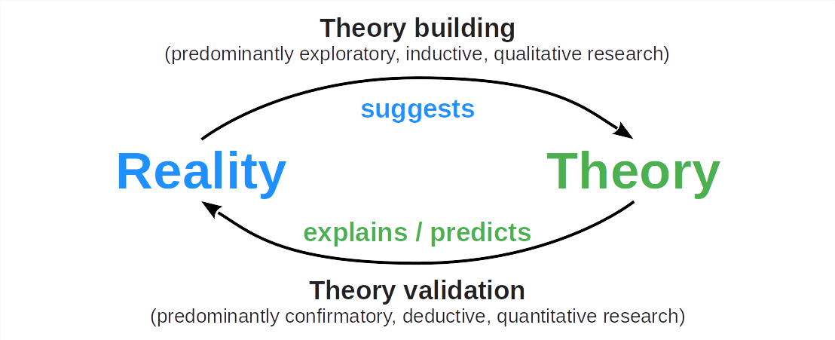
The Logic and Process of Science (Recap)

Slide 5
Purpose of Theory Building
The purpose of scientific theory building is to
Create, revise, and build out a theory that
Correctly explains and/or predicts reality
Can can be continuously tested
All in a cost-efficient way

Slide 6
Theory Building Research
Theory building research is
Exploratory
Inductive
Qualitative

Slide 7
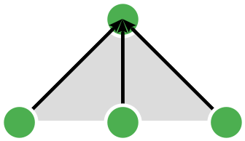
Inductive Reasoning
Inductive research is based on inductive reasoning which is
Abstracting from data by recognizing patterns and drawing conclusions

Slide 8
Theory Building Process
The theory building process
Is iterative
Is incremental
Mitigates risk
Never ends

Slide 9
2. Qualitative Research

Slide 10
Base Terminology (Recap)
Researchers use a research methodology
Recap: A start-to-finish framework for how to perform theory building
To create a research design
Recap: A process description of how to answer a research question
That utilizes research methods
Recap: A method of how to answer a type of research question
Which are based on research practices
Recap: A way of doing something with a defined outcome

Slide 11
What Makes a Research Design a Qualitative Design?
The theory building purpose
The use of theoretical sampling in data collection
The acquisition and use of qualitative data

Slide 12
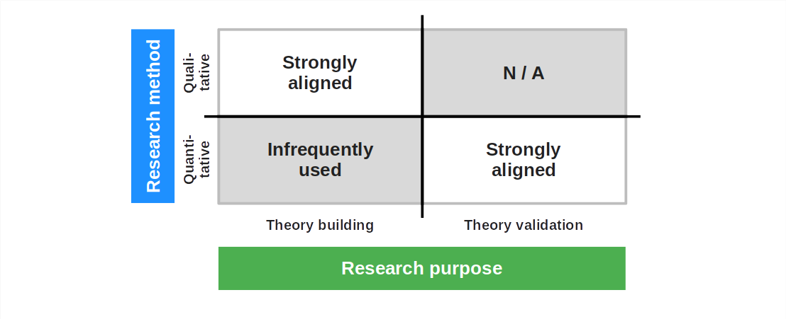
Qualitative vs. Quantitative Research Methods (Recap)

Slide 13
Example Qualitative Research Methodology (Recap)
The qualitative survey according to Jansen (2010)
Write research protocol
Build sampling model
Sample for theory building
Perform interviews
Analyze transcriptions
Determine saturation
Iterate or conclude

Slide 14
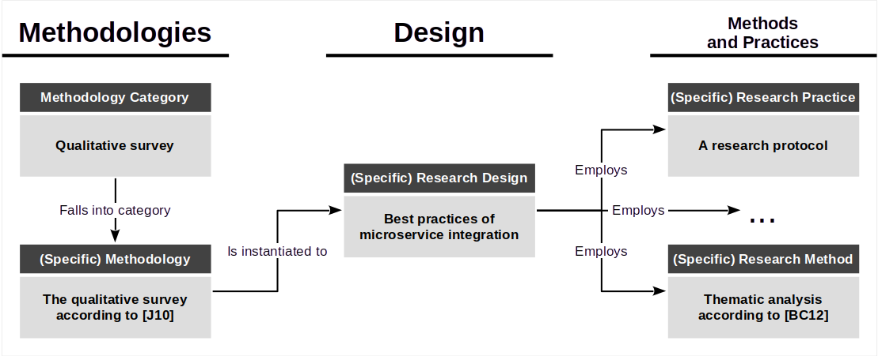
Example Research Design and Its Context

Slide 15
3. Example Methodologies

Slide 16
Research Methodologies
Main categories
Literature survey
Qualitative survey
Action research
Case study research
Design science research
Grounded theory
Ethnographies
Not a methodology
Introspection

Slide 17
Action Research
Action research is a research methodology in which the researcher
Applies a theory being built to help create a desired outcome
Evaluates the theory as to its trustworthiness
Participatory action research is action research in which the researcher
Joins a case (organization) to work side-by-side with practitioners

Slide 18
Action Research Process
Identify problem
Iterate over action loop
Plan action
Perform action
Reflect on action
Specify learning

Slide 19
Example (Specific) Action Research Methodologies
Action research according to Lewin (1946)
Participatory action research according to McIntyre (2007)
Critical participatory action research according to Kemmis et al. (2014)

Slide 20
Case Study Research
Case study research is a research methodology in which the researcher
Investigates a (contemporary) phenomenon it its original context
Where the boundaries between phenomenon and context are blurry

Slide 21
Case Study Research Process
Plan
Perform
Design (case selection, units of analysis, propositions, questions, logic, criteria)
Prepare (research protocol, ethics approval, conflicts of interest, pilot case)
Collect (multiple data sources, case study database, chain of evidence)
Analyze (qualitative data analysis, case description, rival explanations)
Report

Slide 22
Example (Specific) Case Study Research Methodologies
Case study research according to Eisenhardt (1989)
Case study research according to Yin (2017)
Case study research in software engineering Runeson et al. (2012)

Slide 23
4. Multi-Method Research

Slide 24
Multi-Method Research Designs
A multi-method research design is a research design that
Uses multiple methodologies and methods
Within either theory building or validation research

Slide 25
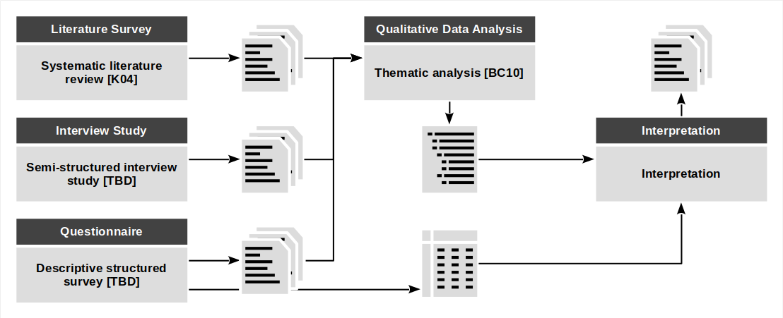
Example Problem Identification in Design Science Research

Slide 26
Example Multi-Method Research Design
Microservices integration
Qualitative survey [J10] (for the initial theory)
Participatory action research [K+13] (for theory build-out)
Case study research [Y17] (for theory evaluation)

Slide 27
5. Mixed-Methods Research

Slide 28
Mixed-Methods Research Design
A mixed-methods research design is a research design that
Combines qualitative with quantitative research methods

Slide 29
Example Mixed-Method Research Design
Collaborative data engineering
Structured literature review [K04] for problem identification
Case study research [RH09] for evaluation and revision
Controlled experiment [K+15] for experimental validation

Slide 30
Example Evaluation in Design Science Research
Language efficiency evaluation
Controlled experiment [W12]
Interview study [J10] for causal analysis

Slide 31
6. Quality Assurance

Slide 32
Quality Criteria for Research Methods [G81] (Recap)
Intuition | Qualitative research | Quantitative research
Truth value | Credibility | Internal validity
Applicability | Transferability | External validity
Consistency | Dependability | Reliability
Neutrality | Confirmability | Objectivity

Slide 33
Trustworthiness [LG85]
Credibility is
The degree of confidence in the truth of the research findings
Transferability is
The degree to which the research findings can be transferred to another context
Dependability is
The stability of research findings over time
Confirmability is
The degree to which the research findings can be confirmed by other researchers

Slide 34
Quality Establishment, Not Assurance
Quality in qualitative research is “established” [LG85]
Quality is proactively backed into the methods

Slide 35
Practices for Establishing Quality
Credibility
Prolonged Engagement
Persistent Observation
(Different forms of) triangulation
Peer debriefing
Negative case analysis
Referential adequacy
Member-checking
Transferability
Thick description
Dependability
Inquiry audit
Confirmability
Confirmability audit
Audit trail
Triangulation
Reflexivity

Slide 36
Summary
Theory building
Qualitative research
Example methodologies
Multi-method research
Mixed-methods research
Quality assurance

Slide 37
Thank you! Any questions?
dirk.riehle@fau.de – https://oss.cs.fau.de
dirk@riehle.org – https://dirkriehle.com – @dirkriehle

Slide 38
Legal Notices
License
Licensed under the CC BY 4.0 International license
Copyright
© 2012-2023 Dirk Riehle, some rights reserved

